Slide 1




FCPS 2023-24
DRAFT SCHOOL YEAR CALENDAR

Slide 2
Calendar Decision-making Criteria
Federal, State, and VDOE guidance
Superintendent’s priorities
School Board input
Surrounding jurisdictions’ calendars
Student absentee data
Staff absentee data
Survey and webinar results
Calendar Feedback Committee input

Slide 3
Calendar Decision-making Criteria
State & Federal Law | Must have a secular reason to establish a holiday Must provide 180 days or 990 hours of instruction
Superintendent Priorities | Alignment with Strategic Plan goals and ongoing commitment to a deep and authentic sense of belonging for each and every member of the FCPS community. High quality teaching and learning experiences. Adequate staffing to maintain school division operations. Educators have professional development opportunities to extend and deepen their learning in support of our mission driven division work.
FCPS 2023-24 DRAFT SCHOOL YEAR CALENDAR
3

Slide 4
Calendar Decision-making Criteria
School Board Top Priorities | Multi-year calendar that allows for forward planning Alignment with surrounding divisions Instructional continuity Data-driven to ensure clarity around decisions made Follows the law Respectful of religious holidays
FCPS 2023-24 DRAFT SCHOOL YEAR CALENDAR
4

Slide 5
Calendar Decision-making Criteria
Surrounding Jurisdictions’ Calendars 2023-24
 | Loudoun County | Prince William County | Arlington County | Alexandria City | Montgomery County
First Day of School | August 24 | August 21 | August 28 | August 21 | August 28
Rosh Hashanah |  | Observed September 15
Yom Kippur | Holiday | Holiday | Holiday | Holiday | Holiday
Election Day | Student Holiday | Student Holiday | Student Holiday | Student Holiday | Student Holiday
Veterans Day |  | Observed November 10 | Observed November 10 |  | Student Holiday
Diwali | Observed November 14
Winter Break | December 21 - January 1 | December 21 - January 1 | December 21 - January 1 | December 18 - January 1 | December 25 - January 1
Lunar New Year | Observed February 9
Spring Break | March 25 - 29 | March 25 - 29 | March 25 - 29 | March 25 - 29 | March 25 - April 1
Eid Al-Fitr | Holiday | Holiday | Holiday | Holiday
Last Day of School | June 14 | June 7 | June 14 | June 14 | June 13
Eid Al-Adha | Summer Break | Summer Break | Summer Break | Summer Break | Summer Break
Instructional Days | 180 | 180 | 180 | 178 | 182
FCPS calendar comparisons for 2022-23 and 2023-24 (drafts) are attached to the agenda item in BoardDocs

Slide 6
Calendar Decision-making Criteria
Student and Staff Absence Data | Absence data has been collected and is posted to BoardDocs for the following dates:
Bodhi Day
Día de los Muertos (11/1)
Día de los Muertos (11/2)
Diwali*
Eid Al-Adha
Eid al-Fitr*
First day of Ramadan
Lunar New Year
Orthodox Christmas
Orthodox Epiphany
Orthodox Good Friday
Passover - 1st Full Day
Passover - Last Day
Rosh Hashanah – 1st Full Day*
Theravada
Three Kings Day/Epiphany
Veterans Day
Yom Kippur*
FCPS 2023-24 DRAFT SCHOOL YEAR CALENDAR
6
*Holiday recognized by at least three surrounding jurisdictions

Slide 7
Calendar Decision-making Criteria
Calendar Survey and Webinar Highlights | All groups preferred full student holidays for professional development days Employees with a preference preferred shortening the school day to accommodate extra planning time; families and the community preferred clustered student holidays No group favored extending the school year to add additional student holidays Employees were unwilling to shortening Spring and Winter Breaks; families and the community were willing to shorten Winter Break by one day and to have school the day before Thanksgiving; students were willing to shorten Spring Break by one day
FCPS 2023-24 DRAFT SCHOOL YEAR CALENDAR
7

Slide 8
Calendar Decision-making Criteria
Calendar Survey Highlights | All groups were somewhat happy with this year’s calendar Employees and students preferred starting two weeks before Labor day; families and the community favored starting one week before the holiday All groups preferred longer Winter and Spring Breaks Families preferred a fixed date for Spring Break; students, employees and the community preferred it to rotate with the timing of Easter Alignment with surrounding jurisdictions was considered extremely important by employees; somewhat important by students; not at all important by families and the community
Complete survey results are attached to the agenda item in BoardDocs
FCPS 2023-24 DRAFT SCHOOL YEAR CALENDAR
8

Slide 9
Calendar Decision-making Criteria
Calendar Feedback Committee Priorities
 | Priority 1 | Priority 2 | Priority 3
Group 1 | Consistency: childcare issues, neighboring county consistency, knowing in advance what was going to happen. | Inclusion and recognition of different holidays and belief systems | Have a longer-term calendar plan so that people can plan.
Group 2 | No synchronous or asynchronous instruction - it is not accessible or equitable for multiple populations. | Keep length of school year the same (shorter would be OK, as long as there is no negative impact to instructional time and teacher preparation) | Keeping the religious diversity in the calendar - find creative ways to address the childcare and food insecurity concerns - collaborate with community & support staff
Group 3 | consistency of learning time | Not to touch winter and spring break (aligned with Easter) | keep religious holidays
Group 4 | Basic skeleton framework of the calendar is consistent & predictable year to year | It appears across all groups that the longer winter break and spring break are the priority | Avoid asynchronous days as a solution to the number of days issue
Group 5 | Keep the religious holidays for students and teachers. | Avoid Asynchronous learning and keep more face-to-face teaching time | Consider early school opening dates based on the equity and teachers satisfaction
Group 6 | needs to be a focus on operational needs | need creative solutions to balance needs of religious minorities, differently abled, economically disadvantaged, military and others who are not always able to participate - because large minorities appear in almost all survey questions | we did not get to a third
Additional information on the Calendar Feedback Committee is attached to the agenda item in BoardDocs

Slide 10
2023-24 Draft
Proposed Calendars:
Blue
Orange
Green
Purple

Slide 11
Framework for Draft FCPS Calendars: Key Differences
FCPS Proposed Draft Calendars
Date | Blue Version | Orange Version | Green Version | Purple Version
First Day of School | 2 weeks before Labor Day | 2 weeks before Labor Day | 1 week before labor day | 2 weeks before Labor Day
Winter Break | Two weeks | Less than two weeks | Less than two weeks | Two weeks
Last Day of School | Variable | Variable | Variable | Variable
Instructional Days | 180 | 180 | 180 | 177
A complete calendar framework is attached to the agenda item in BoardDocs

Slide 12
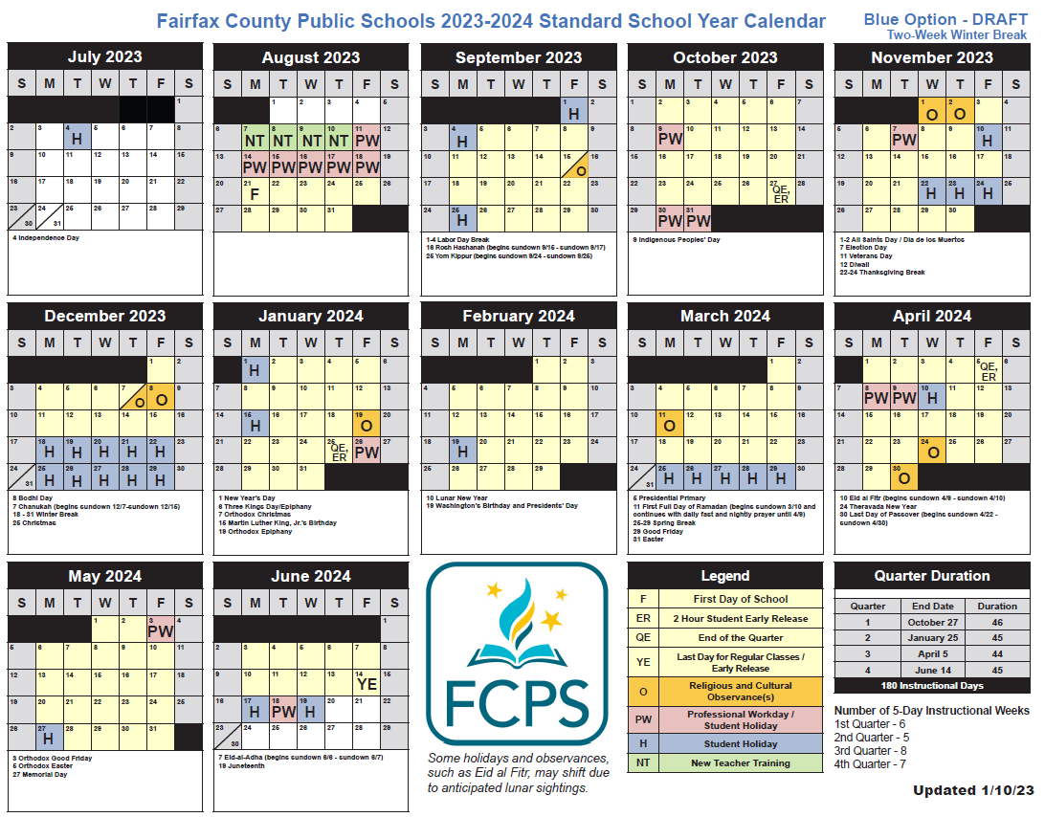
2023-24
Blue Option
Starts: August 21
(2 weeks before Labor Day)
Ends: June 14
Winter Break: 2 weeks + 1 day
Instructional Days: 180
5-day Weeks
Quarter | 2022-23 | 2023-24
Q1 | 4 weeks | 6 weeks
Q2 | 5 weeks | 5 weeks
Q3 | 7 weeks | 8 weeks
Q4 | 7 weeks | 7 weeks
Total | 23 weeks | 26 weeks

Slide 13
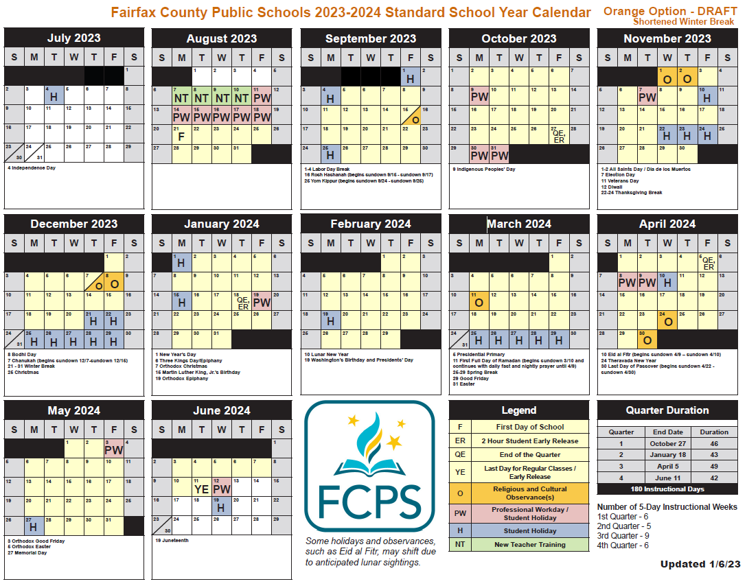
2023-24
Orange Option
Starts: August 21
(2 weeks before Labor Day)
Ends: June 11
Winter Break: 8 days
Instructional Days: 180
5-day Weeks
Quarter | 2022-23 | 2023-24
Q1 | 4 weeks | 6 weeks
Q2 | 5 weeks | 5 weeks
Q3 | 7 weeks | 9 weeks
Q4 | 7 weeks | 6 weeks
Total | 23 weeks | 26 weeks

Slide 14
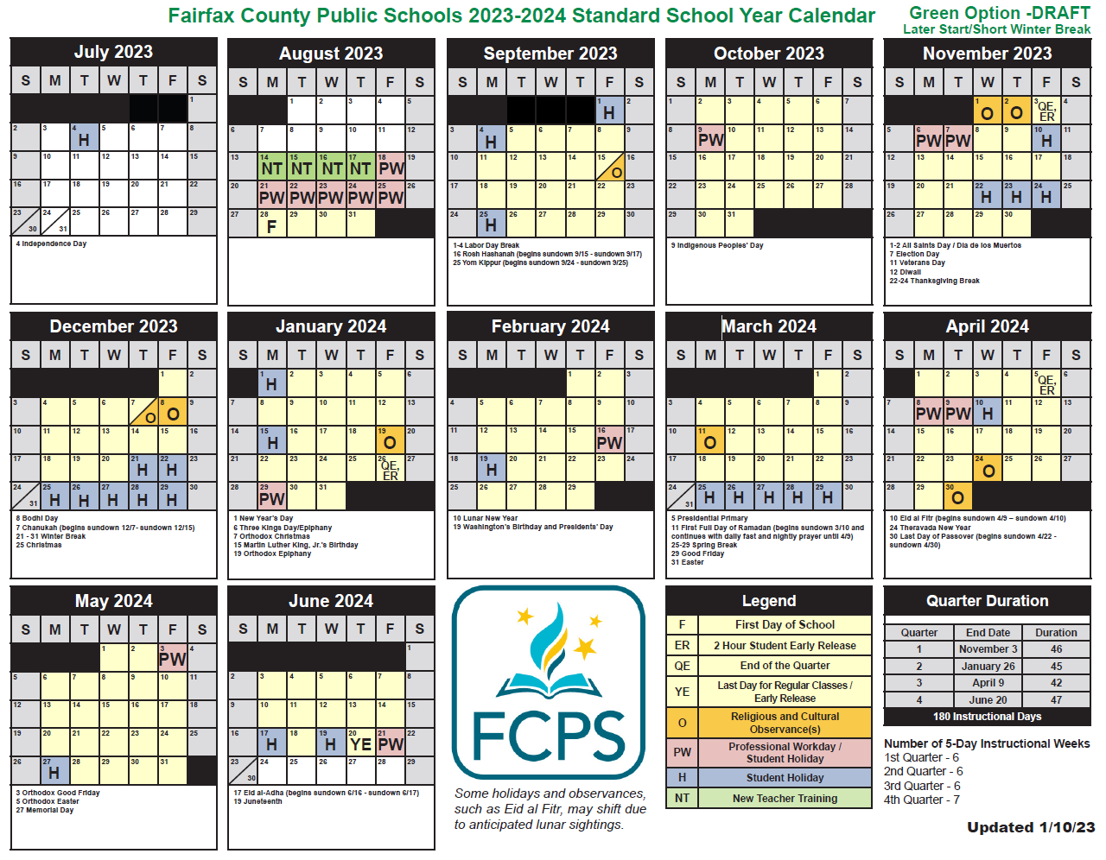
2023-24
Green Option
Starts: August 28
(1 week before Labor Day)
Ends: June 20
Winter Break: 8 days
Instructional Days: 180
5-day Weeks
Quarter | 2022-23 | 2023-24
Q1 | 4 weeks | 6 weeks
Q2 | 5 weeks | 6 weeks
Q3 | 7 weeks | 6 weeks
Q4 | 7 weeks | 7 weeks
Total | 23 weeks | 25 weeks

Slide 15
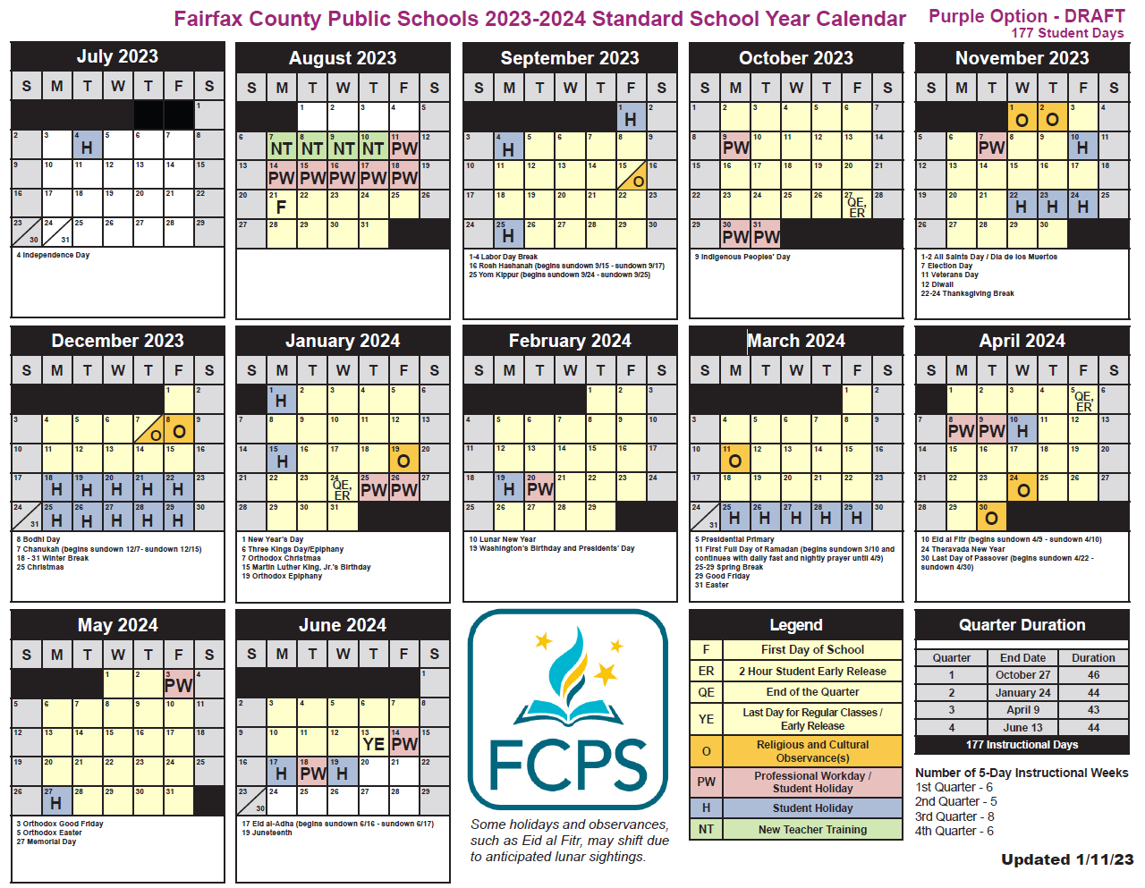
2023-24
Purple Option
Starts: August 21
(2 weeks before Labor Day)
Ends: June 13
Winter Break: 2 weeks + 1 day
Instructional Days: 177
5-day Weeks
Quarter | 2022-23 | 2023-24
Q1 | 4 weeks | 6 weeks
Q2 | 5 weeks | 5 weeks
Q3 | 7 weeks | 8 weeks
Q4 | 7 weeks | 6 weeks
Total | 23 weeks | 25 weeks

Slide 16
Questions and Discussion

Slide 17
Appendix

Slide 18
Blue Draft Options:
2024-25
2025-26

Slide 19
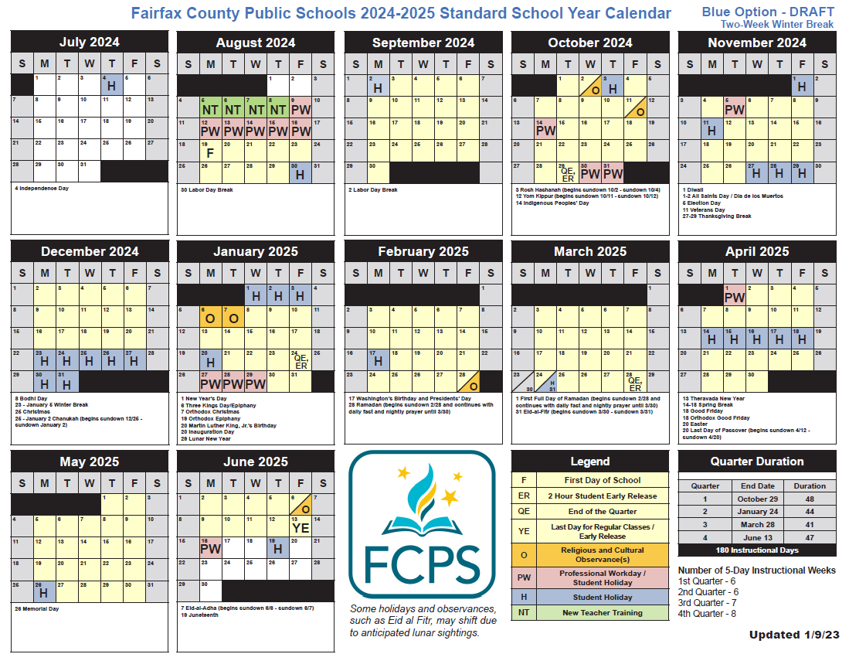
2024-25
Blue Option
Starts: August 19
(2 weeks before Labor Day)
Ends: June 13
Winter Break: 2 weeks
Instructional Days: 180
5-day Weeks
Quarter | 2022-23 | 2024-25
Q1 | 4 weeks | 6 weeks
Q2 | 5 weeks | 6 weeks
Q3 | 7 weeks | 7 weeks
Q4 | 7 weeks | 8 weeks
Total | 23 weeks | 27 weeks

Slide 20
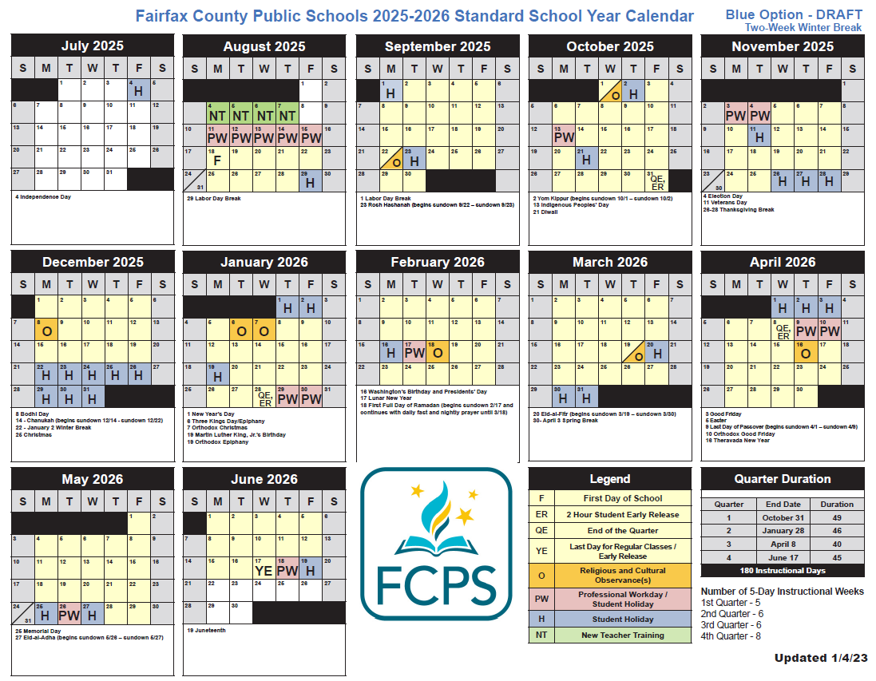
2025-26
Blue Option
Starts: August 18
(2 weeks before Labor Day)
Ends: June 17
Winter Break: 2 weeks
Instructional Days: 180
5-day Weeks
Quarter | 2022-24 | 2025-26
Q1 | 4 weeks | 5 weeks
Q2 | 5 weeks | 6 weeks
Q3 | 7 weeks | 6 weeks
Q4 | 7 weeks | 8 weeks
Total | 23 weeks | 25 weeks

Slide 21
Orange Draft Options:
2024-25
2025-26

Slide 22
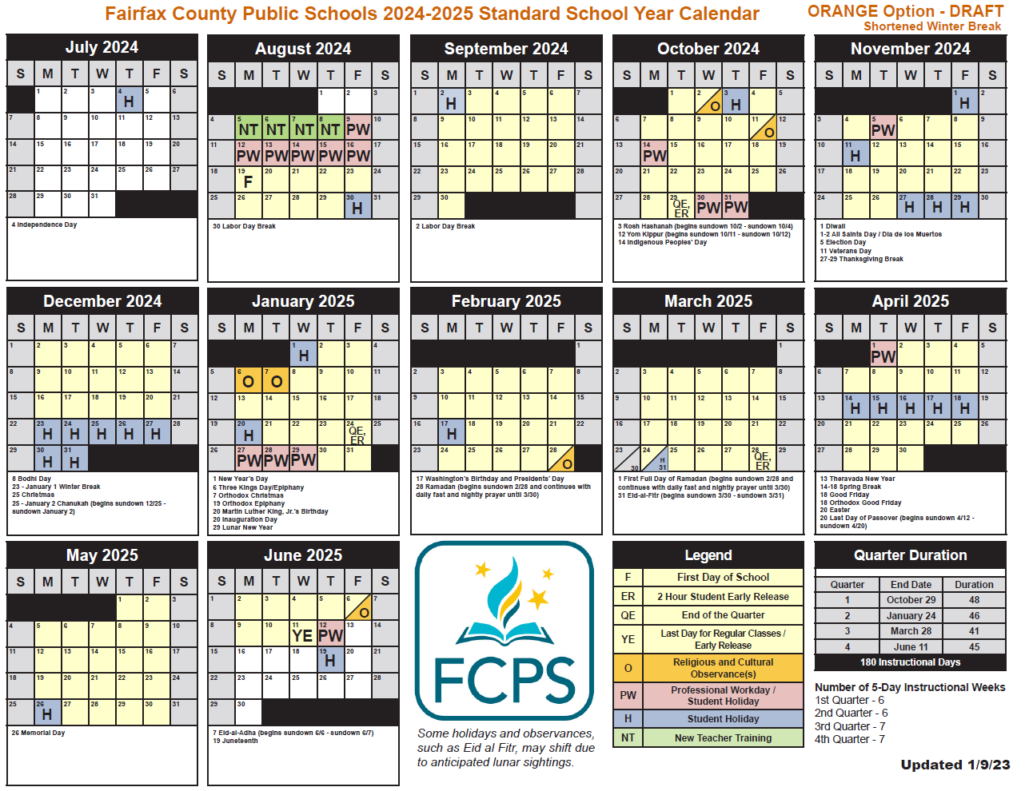
2024-25
Orange Option
Starts: August 19
(2 weeks before Labor Day)
Ends: June 11
Winter Break: 8 days
Instructional Days: 180
5-day Weeks
Quarter | 2022-23 | 2024-25
Q1 | 4 weeks | 6 weeks
Q2 | 5 weeks | 6 weeks
Q3 | 7 weeks | 7 weeks
Q4 | 7 weeks | 7 weeks
Total | 23 weeks | 26 weeks

Slide 23
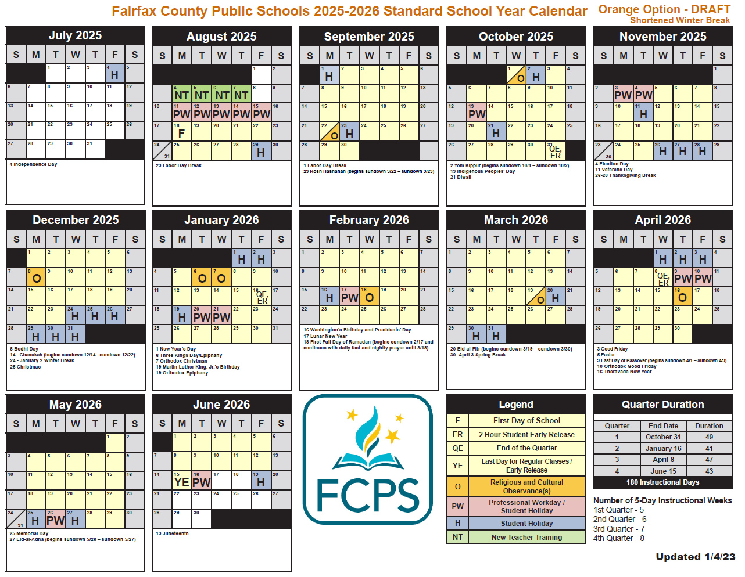
2025-26
Orange Option
Starts: August 18
(2 weeks before Labor Day)
Ends: June 15
Winter Break: 8 days
Instructional Days: 180
5-day Weeks
Quarter | 2022-23 | 2025-26
Q1 | 4 weeks | 5 weeks
Q2 | 5 weeks | 6 weeks
Q3 | 7 weeks | 7 weeks
Q4 | 7 weeks | 8 weeks
Total | 23 weeks | 26 weeks

Slide 24
Green Draft Options:
2024-25
2025-26

Slide 25
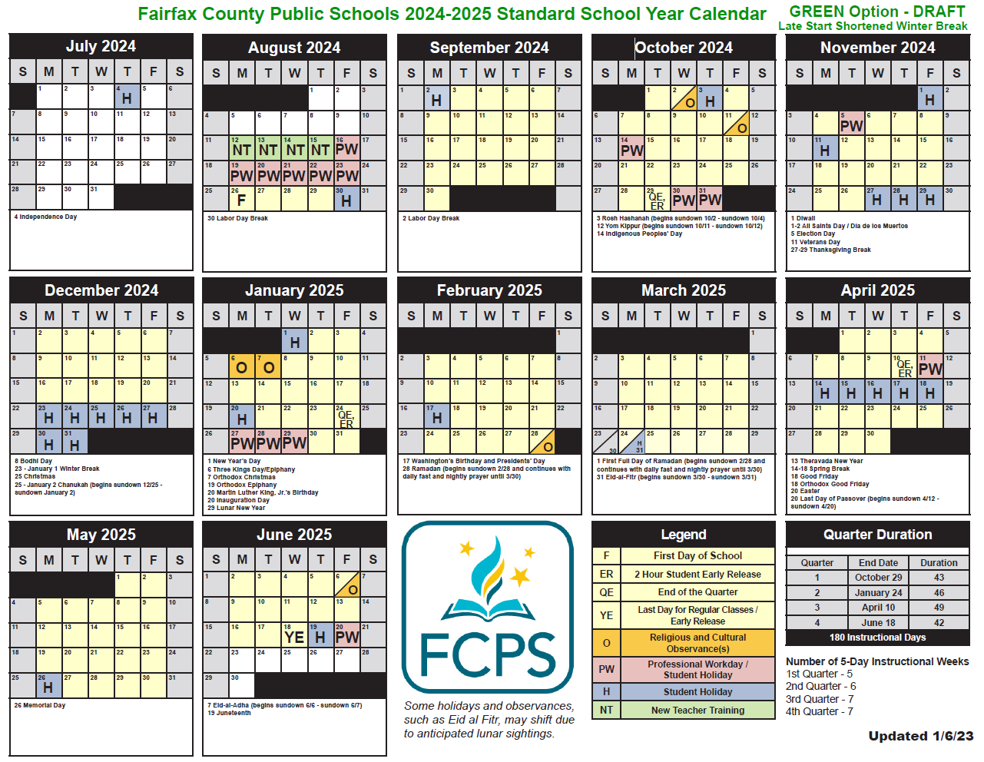
2024-25
Green Option
Starts: August 26
(1 week before Labor Day)
Ends: June 18
Winter Break: 8 days
Instructional Days: 180
5-day Weeks
Quarter | 2022-23 | 2024-25
Q1 | 4 weeks | 5 weeks
Q2 | 5 weeks | 6 weeks
Q3 | 7 weeks | 7 weeks
Q4 | 7 weeks | 7 weeks
Total | 23 weeks | 25 weeks

Slide 26
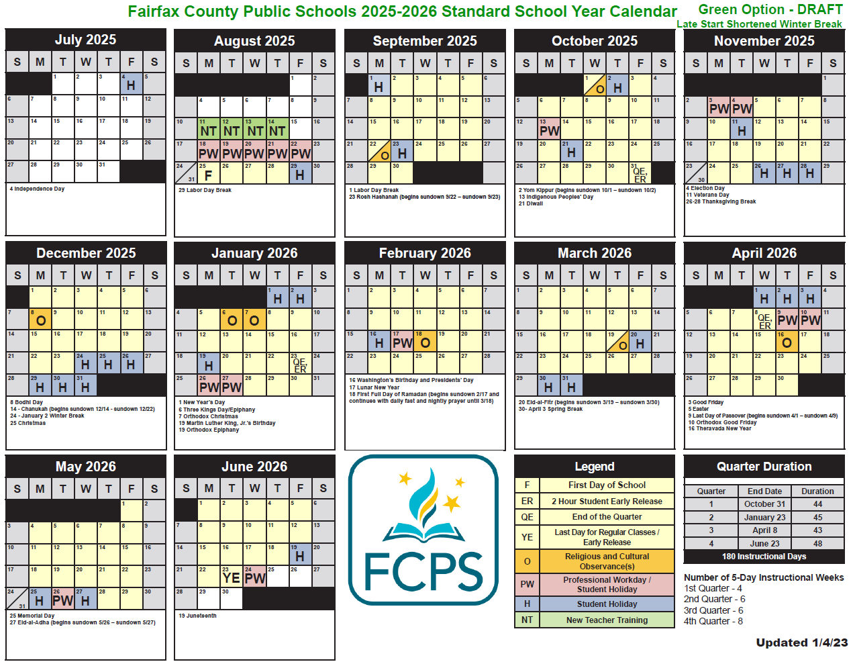
2025-26
Green Option
Starts: August 25
(1 week before Labor Day)
Ends: June 23
Winter Break: 8 days
Instructional Days: 180
5-day Weeks
Quarter | 2022-23 | 2024-25
Q1 | 4 weeks | 4 weeks
Q2 | 5 weeks | 6 weeks
Q3 | 7 weeks | 6 weeks
Q4 | 7 weeks | 8 weeks
Total | 23 weeks | 24 weeks

Slide 27
Purple Draft Options:
2023-24
2024-25

Slide 28
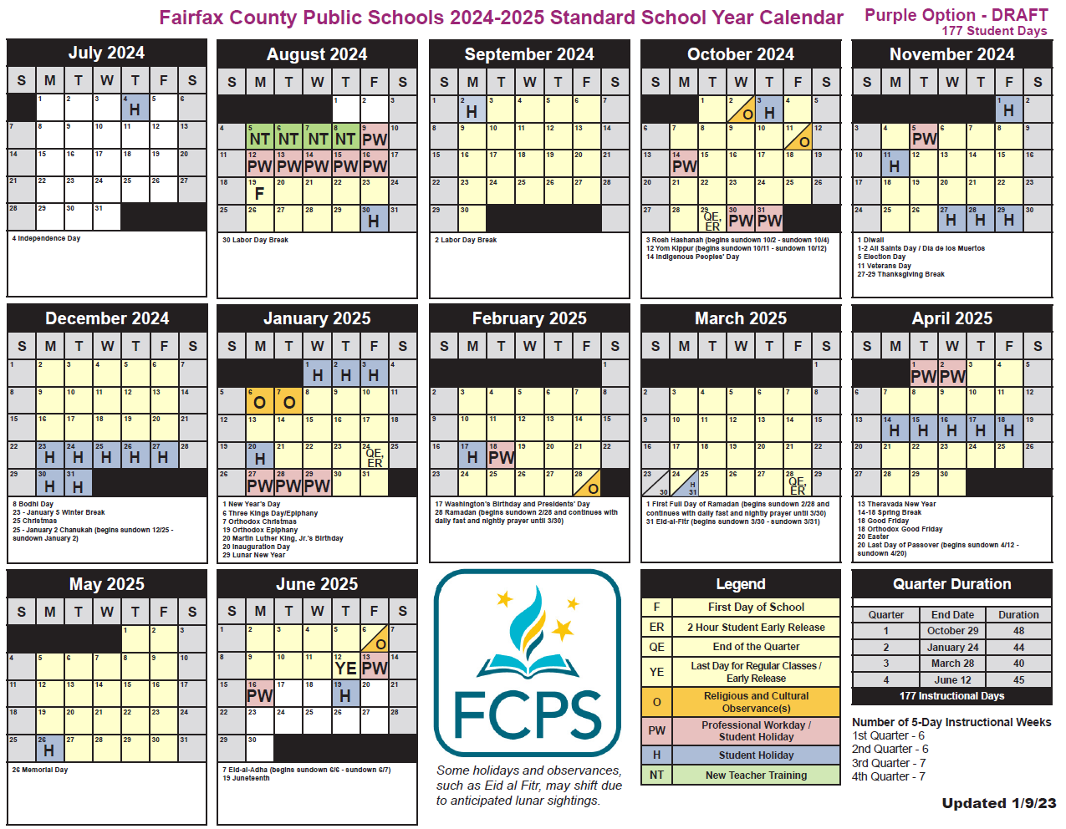
2024-25
Purple Option
Starts: August 19
(2 weeks before Labor Day)
Ends: June 12
Winter Break: 2 weeks
Instructional Days: 177
5-day Weeks
Quarter | 2022-23 | 2024-25
Q1 | 4 weeks | 6 weeks
Q2 | 5 weeks | 6 weeks
Q3 | 7 weeks | 7 weeks
Q4 | 7 weeks | 7 weeks
Total | 23 weeks | 26 weeks

Slide 29
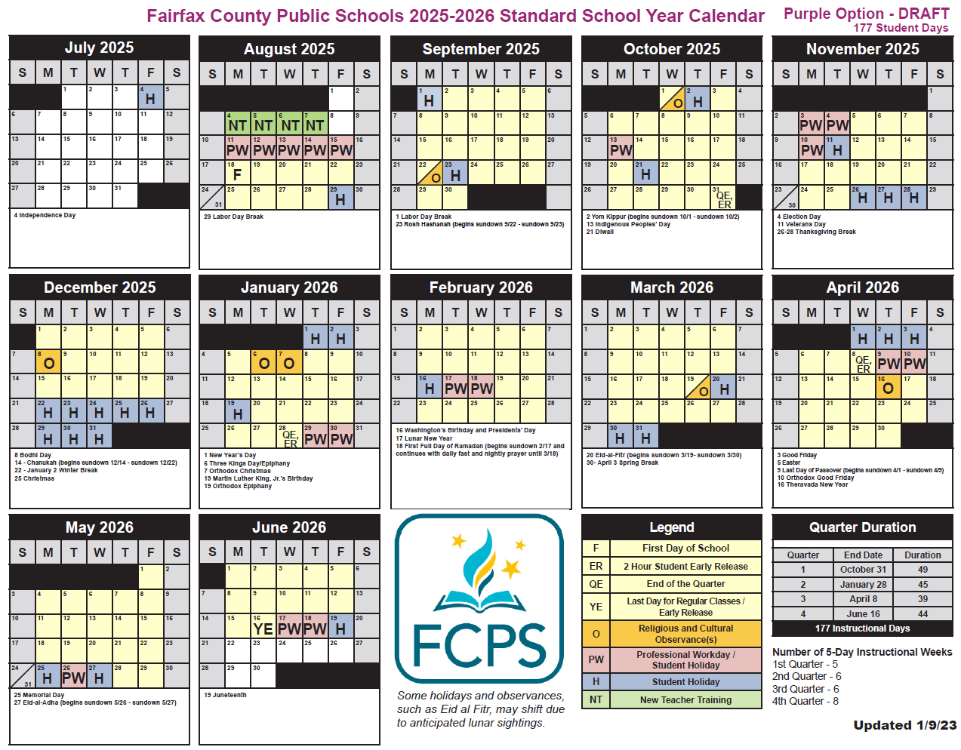
2025-26
Purple Option
Starts: August 18
(2 weeks before Labor Day)
Ends: June 16
Winter Break: 2 weeks
Instructional Days: 177
5-day Weeks
Quarter | 2022-23 | 2025-26
Q1 | 4 weeks | 5 weeks
Q2 | 5 weeks | 6 weeks
Q3 | 7 weeks | 6 weeks
Q4 | 7 weeks | 8 weeks
Total | 23 weeks | 25 weeks

Slide 30

Upon request, an individual with a disability as defined by the ADA may be provided with this document in an alternative format accessible by contacting the Office of Communication and Community Relations at 571-423-1200

